Slide 1

P30:Review Analysis for Mi 360° 1080p Full HD WiFi Smart Security Camera Product on Amazon.
By Group-6
1.Minal Nirmal.

Slide 2
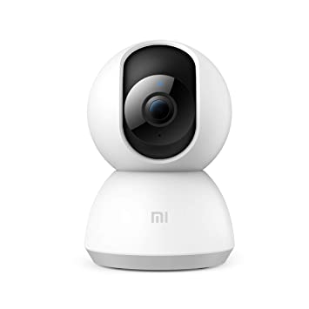
Business Problem:
Business objective-
The main aim of the project is to analyze the review for Mi 360° 1080p Full HD WiFi Smart Security Camera product on Amazon and build an algorithm to find and classify the emotions as Positive, Negative

Slide 3
Project Architecture / Project Flow
1.Understanding Business Objective
.
2.Getting data set details
3.EDA:Exploratory Data Analysis
4.Model Building
5.Evaluate the model
6.Data Visualizations
7.Deployment Frame

Slide 4
Exploratory Data Analysis (EDA) and Feature Engineering

Slide 5
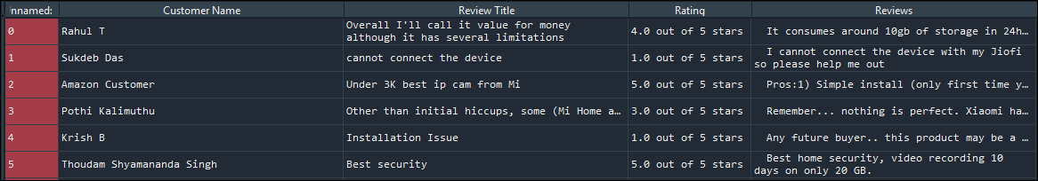
Data set details
The data set has 5 columns and 4210 rows.
Contains zero missing values.
Consists of categorical/alphanumeric values.
There are no duplicate values.
These are the explanations for variables.
Customer name (object): Customer names who bought the camera.
Review Title (object):Title of the reviews given by the customers.
Rating (object): Rating by customers on Camera.
Reviews (object):Customer reviews

Slide 6

EDA:- Data Pre-processing steps :-
removing punctuations & Whitespaces
removing stop words
Lemmatization
Top 20 Frequent words
word cloud generation
top 10 bigrams
Sentimental Analysis
.

Slide 7
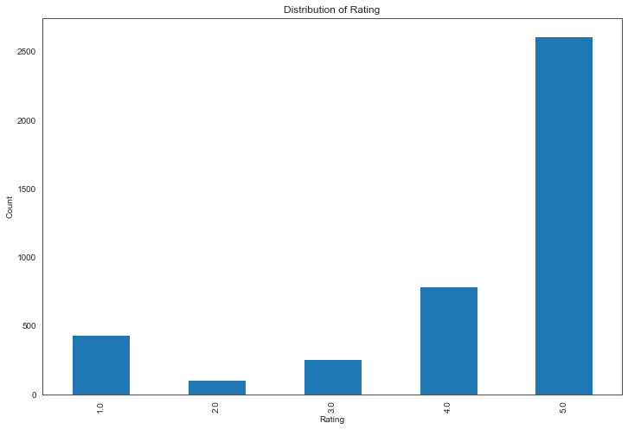
Data Visualization :
The above graph represents the distribution of ratings on the product. The rating is given in the range of 0 to 5

Slide 8
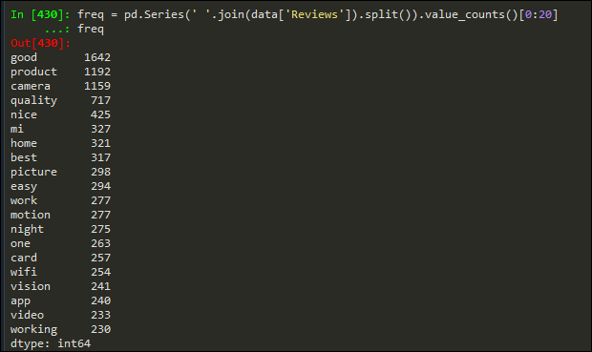
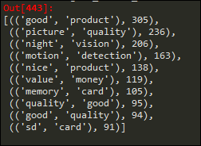
EDA.
.
The above table represents the top 20 words used in the reviews column
The table represents the top 10 bigrams in the reviews column.

Slide 9
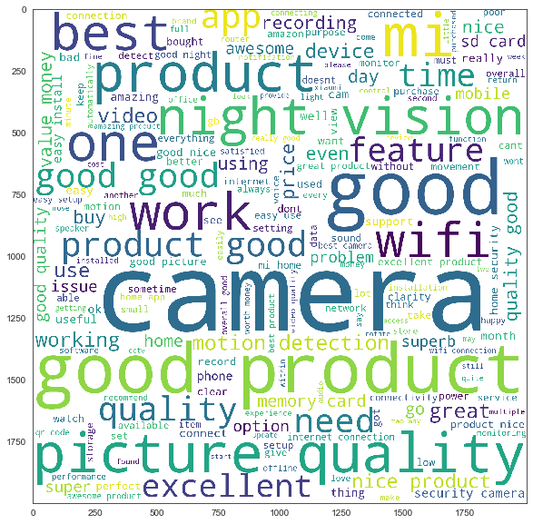
WordCloud:
Word cloud represents the combination of positive, negative and neutral words from Reviews of the customers
‘
.
.

Slide 10

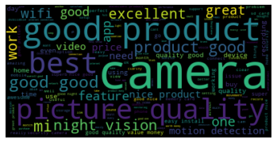
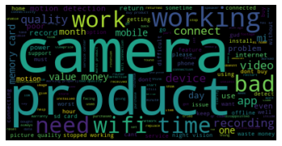
Word Cloud for Positive and Negative words
Wordcloud for top 150 Positive words in the Reviews column of the dataset
Wordcloud for top 150 Negative words in the Reviews column of the dataset

Slide 11
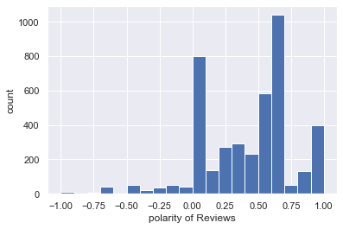
Most of the observation in Reviews are positive. Positive polarity reaches till 1 and negative polarity up to -1.
.

Slide 12
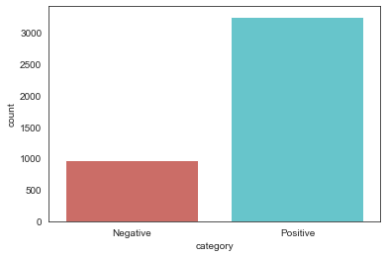
.
Here we considered the polarities which are above as positive and polarity values less than and equal to zero as negative. So Category is dependent variable and Reviews is independent variable. Also we can observe Positive reviews are move compared to negative reviews.

Slide 13
Model Building
.

Slide 14

Model Building
Following are the models used for Model building in this project:
1)Logistic regression.
2) MultinomialNB
3) BernoulliNB
4) Support Vector Machine(SVM) Classifier.
5)Decision tree classifier.
6)Neural Networks

Slide 15
Model building Results before SMOTE:
Model Used | Category | Precision | Recall | f1-score | Accuracy of Model
Logistic Regression | Negative | 0.87 | 0.44 | 0.58 | 0.86
 | Positive | 0.85 | 0.98 | 0.91
MultinomialNB | Negative | 0.87 | 0.27 | 0.41 | 0.82
 | Positive | 0.82 | 0.99 | 0.90
BernoulliNB | Negative | 0.68 | 0.34 | 0.46 | 0.81
 | Positive | 0.83 | 0.95 | 0.89
SVM Classifier | Negative | 0.76 | 0.72 | 0.74 | 0.88
 | Positive | 0.92 | 0.93 | 0.93
Decision Tree Classifier | Negative | 0.69 | 0.78 | 0.73 | 0.87
 | Positive | 0.93 | 0.90 | 0.91
Neural Networks | Negative | 0.72 | 0.72 | 0.72 | 0.87
 | Positive | 0.92 | 0.92 | 0.92

Slide 16
Model building Results after SMOTE:
Model Used | Category | Precision | Recall | f1-score | Accuracy of Model
Logistic Regression | Negative | 0.67 | 0.86 | 0.75 | 0.87
 | Positive | 0.95 | 0.87 | 0.91
MultinomialNB | Negative | 0.67 | 0.78 | 0.72 | 0.86
 | Positive | 0.93 | 0.88 | 0.91
BernoulliNB | Negative | 0.69 | 0.81 | 0.74 | 0.87
 | Positive | 0.94 | 0.89 | 0.91
SVM Classifier | Negative | 0.71 | 0.79 | 0.75 | 0.88
 | Positive | 0.93 | 0.90 | 0.92
Decision Tree Classifier | Negative | 0.68 | 0.79 | 0.73 | 0.87
 | Positive | 0.94 | 0.89 | 0.91
Neural Networks | Negative | 0.00 | 0.00 | 0.00 | 0.77
 | Positive | 0.77 | 1.00 | 0.87

Slide 17

Model Deployment using
.

Slide 18
Model Deployment
The Model Deployed is Support Vector Machine.
For deployment we have created files like app.py, Transform.pkl and Model.pkl.
Support Vector Machine(Higher Accuracy Model) saved as to Model.pkl.
and TFIDF saved as to vector.pkl and app.py is the Flask deployment code.

Slide 19
Deployment Using flask
Flask File Creation:
Import Flask from flask module
Create an instance of the Flask class
Using @app.route(‘/’) to execute home function which gives home page for this use home.html
Using @app.route(‘/predict’, methods=[POST]) to execute predict function which gives results page for this use final.html.
After execute whole deployment code it gives link like http://127.0.0:5000 run this link to get results.
.

Slide 20
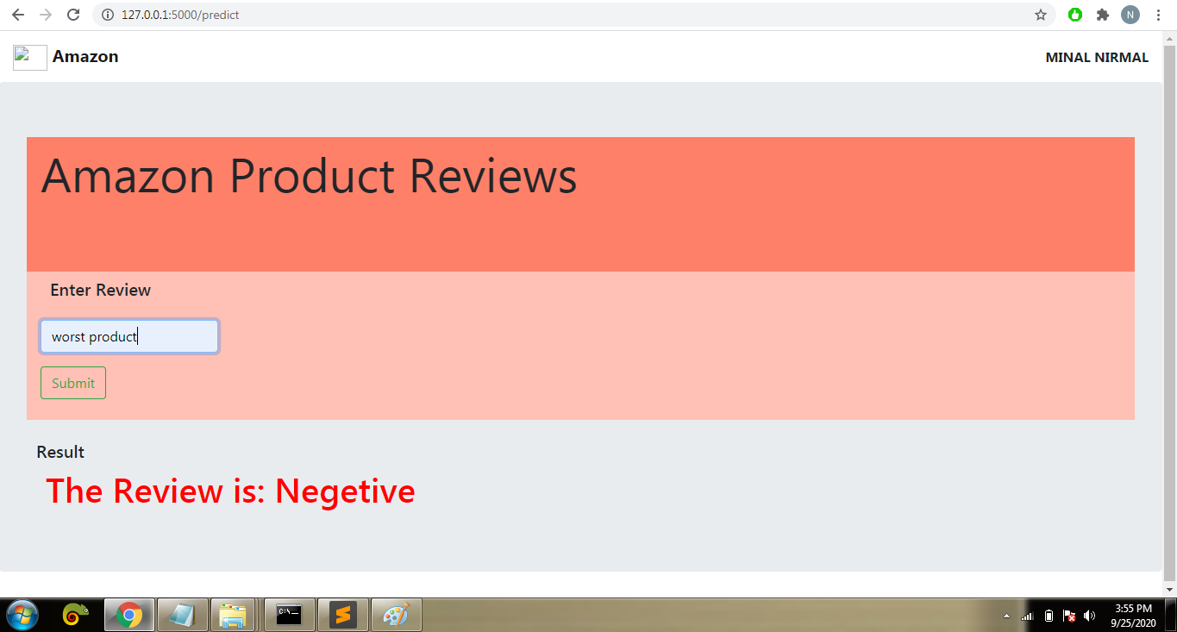
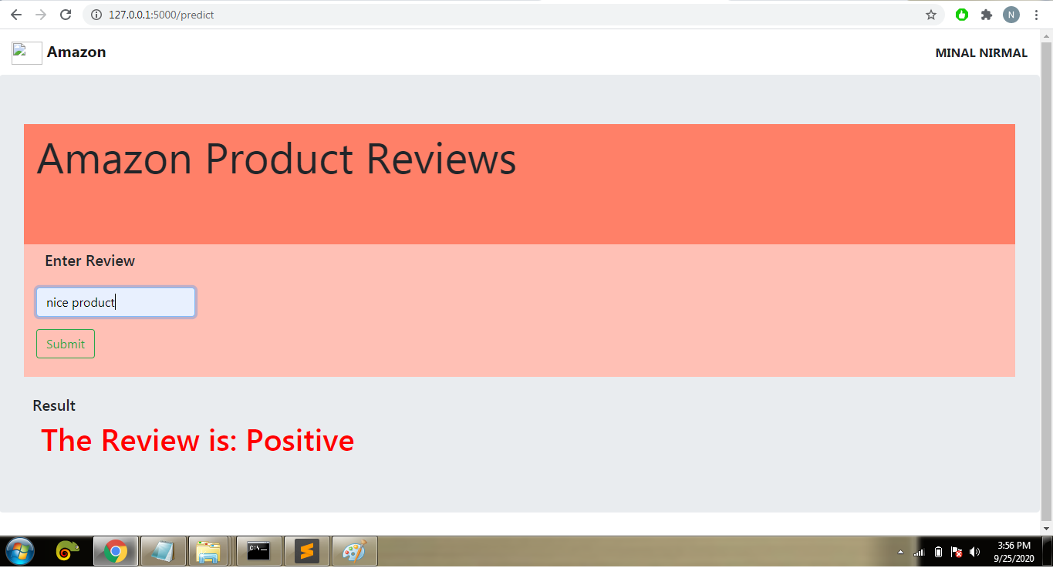
Results:
Home Page
Result Page
.

Slide 21
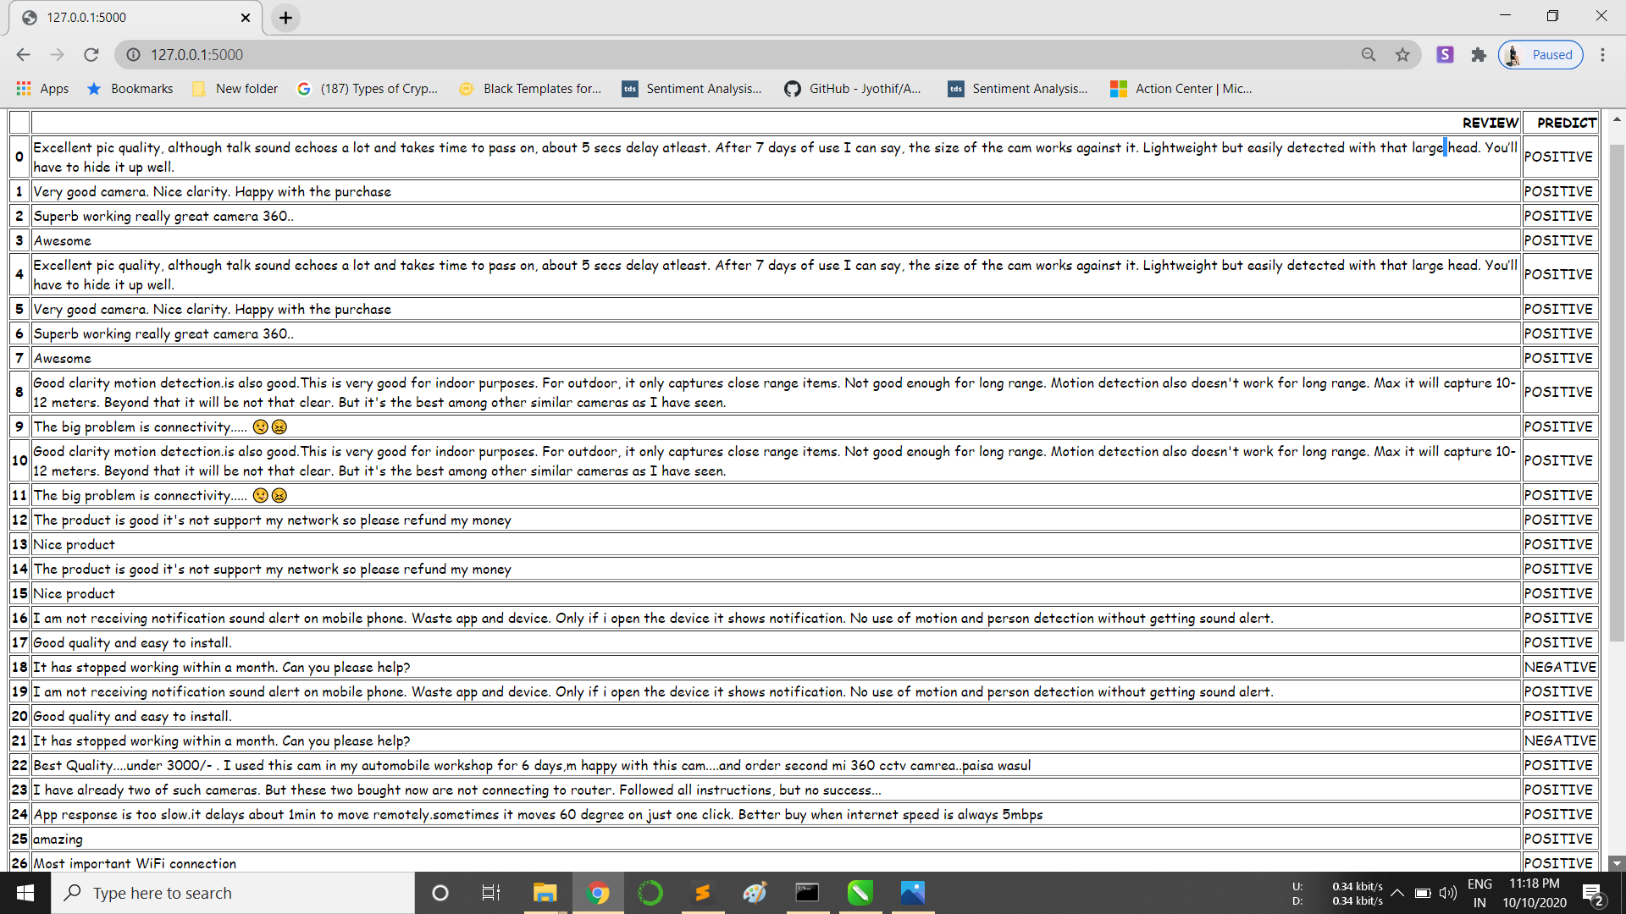
.
.

Slide 22
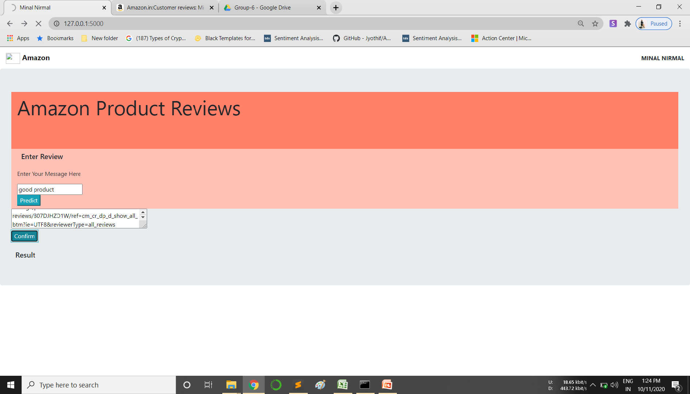
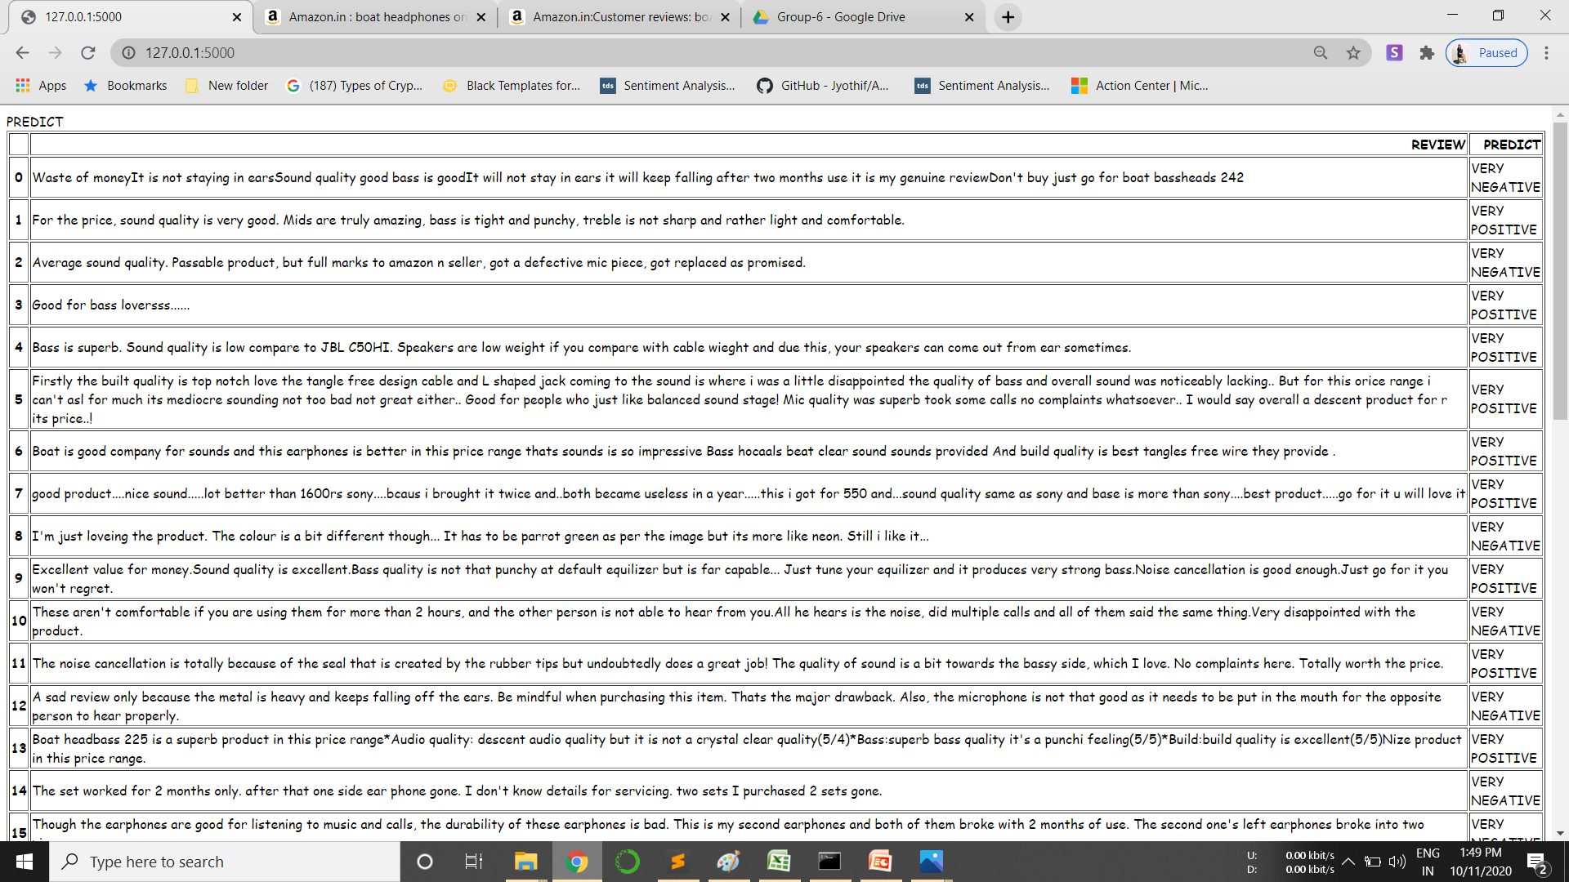
.
.

Slide 23
Thank YOU!

